Slide 1
GetEasy Redesign Mid-Term Project
CSYE7280 – UX Design
Presented by:
Pranjal gupta - 001094676
Noordeep gill - 002194664
Naman Gupta - 002142933
Alisha Angalan - 002102014

Slide 2
Summary & Overview:
GetEasy is an online grocery delivery platform.
The application provides instant delivery where they ship products within 15 minutes.
It also provides the service where they allow customers to select groceries from various retailers and have them delivered by personal shoppers.
The platform works together with local warehouse operators as well as popular retailers.

Slide 3
Problem Statement
Online grocery shopping has seen a significant rise in the past few years due to its convenience and availability through multiple applications. It’s getting more difficult for users to spend time in a grocery shop with a well-thought list due to the following issues:
Users with busy schedules may not find the time it takes to shop for items on a regular basis from nearby stores and wait in line for checkout and put the effort to carry them home
Users may prefer to shop from specific stores that may not be easily accessible to them
Users may want an instant delivery of items, say within 20 minutes.
Users may prefer to order fresh groceries daily for cooking purposes.
Users may prefer to have exact quantities of certain items for a meal of exact numbers

Slide 4
Solution
GetEasy offers solutions to the above issues by:
Enables users to shop from home or on the go and save time.
Providing options for the user to shop from various other retailers.
Helps the users to avoid multiple trips to stores.
Enables the user to get their order instantly (within 15 to 30 mins) or as per select options based on users’ choice.
Enables the users to make an informed decision on the quantity of items required based on certain meals they may intend to make.

Slide 5
Product Objectives
Allows users to navigate to shop from various stores and from inventory
The delivery promise of goods from our inventory within 30 minutes
Easily visible different options for shopping with one membership for free delivery
Have multiple carts for different stores and inventory orders
Give the user an option to schedule an order for now or later by choosing a time frame
Add/Remove cart items till the shopper has started shopping
Ordering the food items according to a recipe user is searching for
Provide quick checkout
Provide secure payment methods, with an option to scan card to add it
A live chatbot feature which allow users to resolve their doubts through an AI and then
rate their experience
Tutorial for first-time users to navigate through the website with an option to skip it
Different authentication methods for user while signing in using credentials.

Slide 6
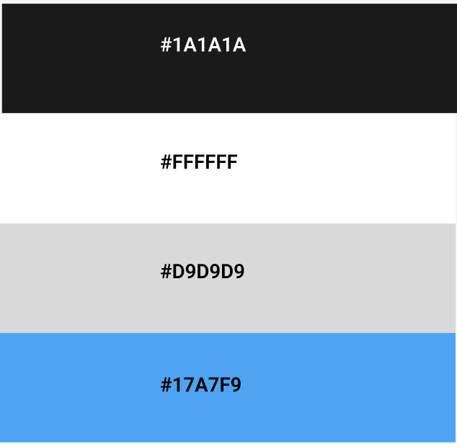
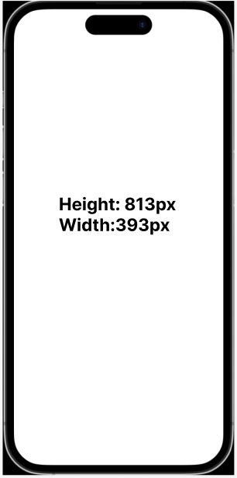
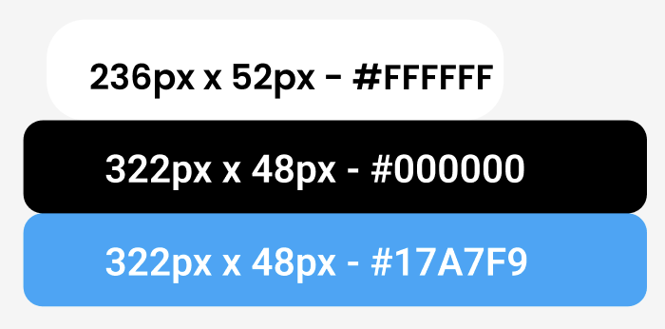
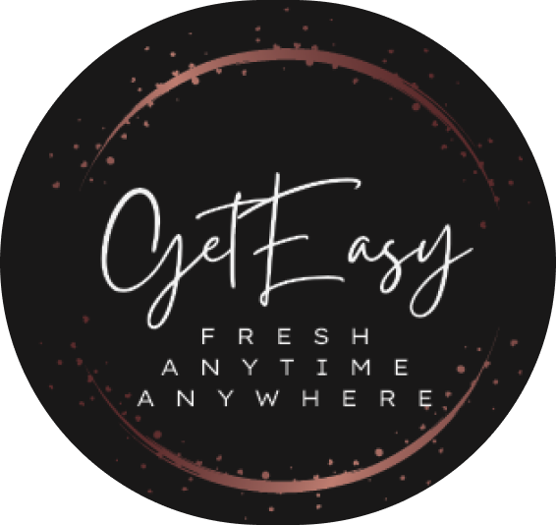
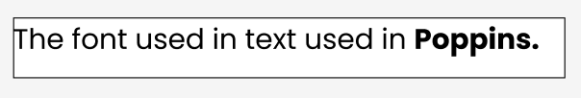
Design System – Style Guide
Color: Dimensions: Buttons: Logo:
Text:

Slide 7
Target Audience
Age Group: 15 - 75
Purchasing behavior segmentation: customers who research and read reviews, thrifty shopping, high spenders, cart abandoners, coupon lovers, one-timers, loyal customers
Demographics: All gender, family size from 1 to more, education level from school to above, any occupation, income from $60k and above
Geographic exposure: Within USA and within 50 miles of retailers and inventory stores
Online Shopping Exposure: Low to high exposure to online shopping
Technical Exposure: Basic knowledge of how to access websites over the Internet
Financial Background: Lower and upper middle-class, working, stay at home people

Slide 8
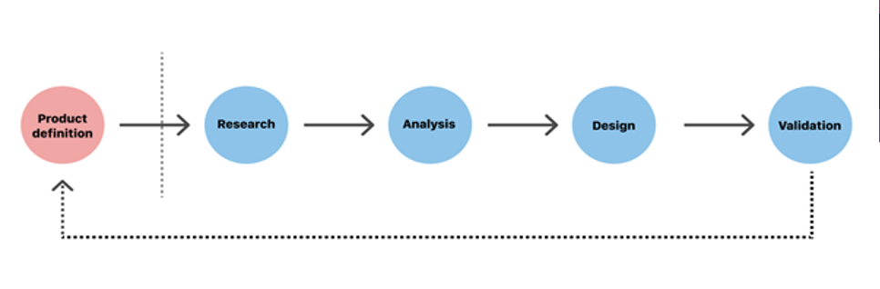
Design Process
Product Definition: Sets the foundation of the outcome. During this phase, UX designers brainstorm around the product at the highest level (basically, the concept of the product) with stakeholders.
Product Research: Includes user research and market research. It can include interviews and competitive research.
Analysis: Draw insights from data collected during the research phase. This phase includes creating personas, user stories, storyboarding.

Slide 9
Design Process
Design: This step includes creating information architecture and then, the actual UI design. An effective design phase is both highly and iterative. It includes sketching, creating wireframes and prototypes, creating a design specification, and design systems.
Validation: This step is the testing phase where it helps the team to understand whether the design works for the users. Its usually tested by the team itself, then through user testing sessions, surveys and quantitative data will be analyzed.

Slide 10
Personas

Slide 11
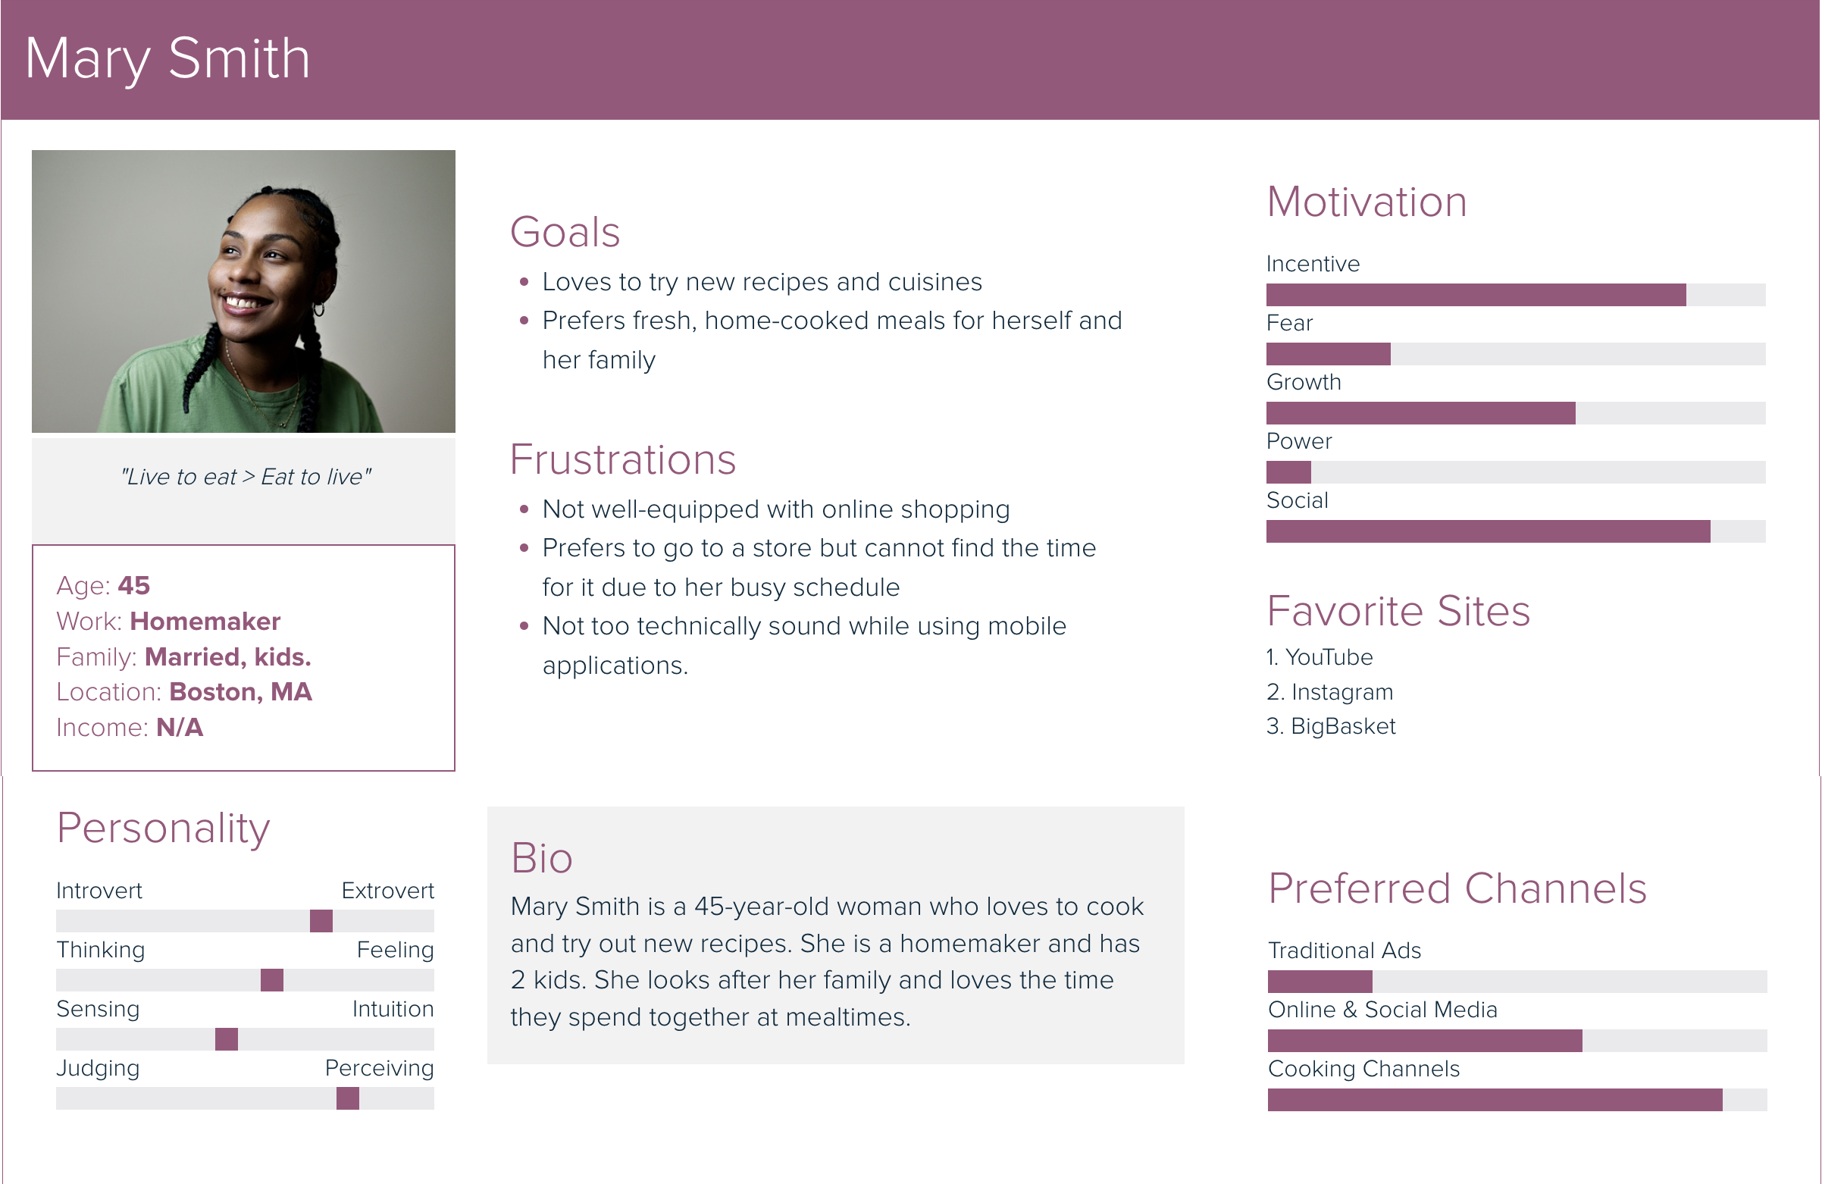

Slide 12
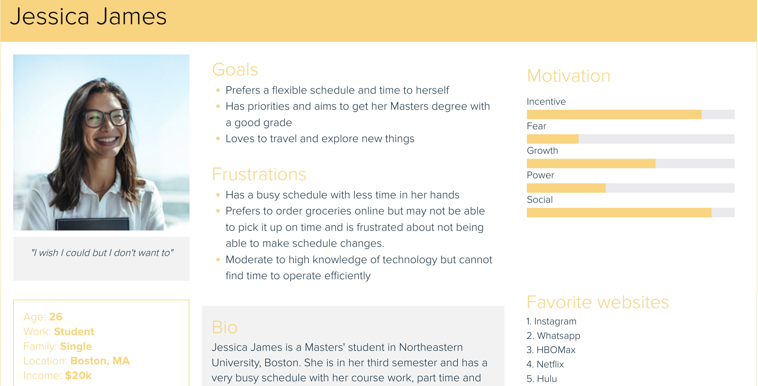

Slide 13
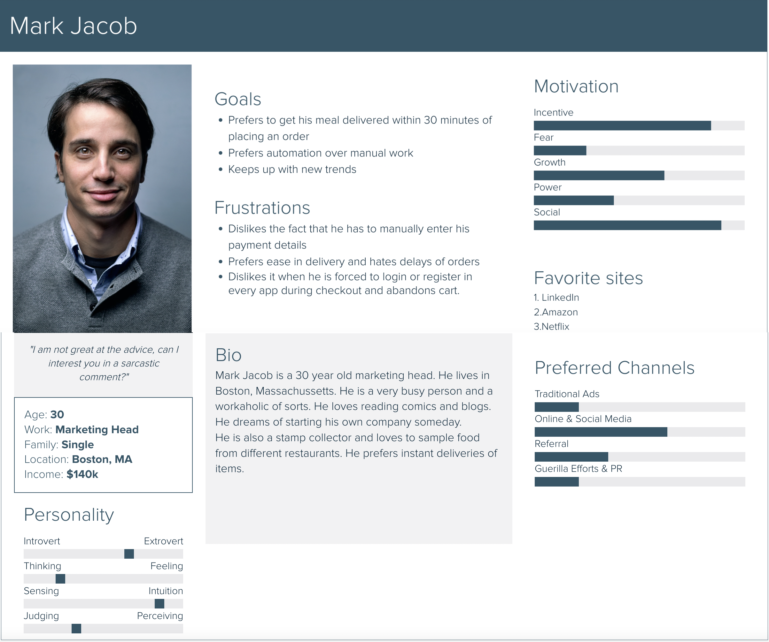

Slide 14
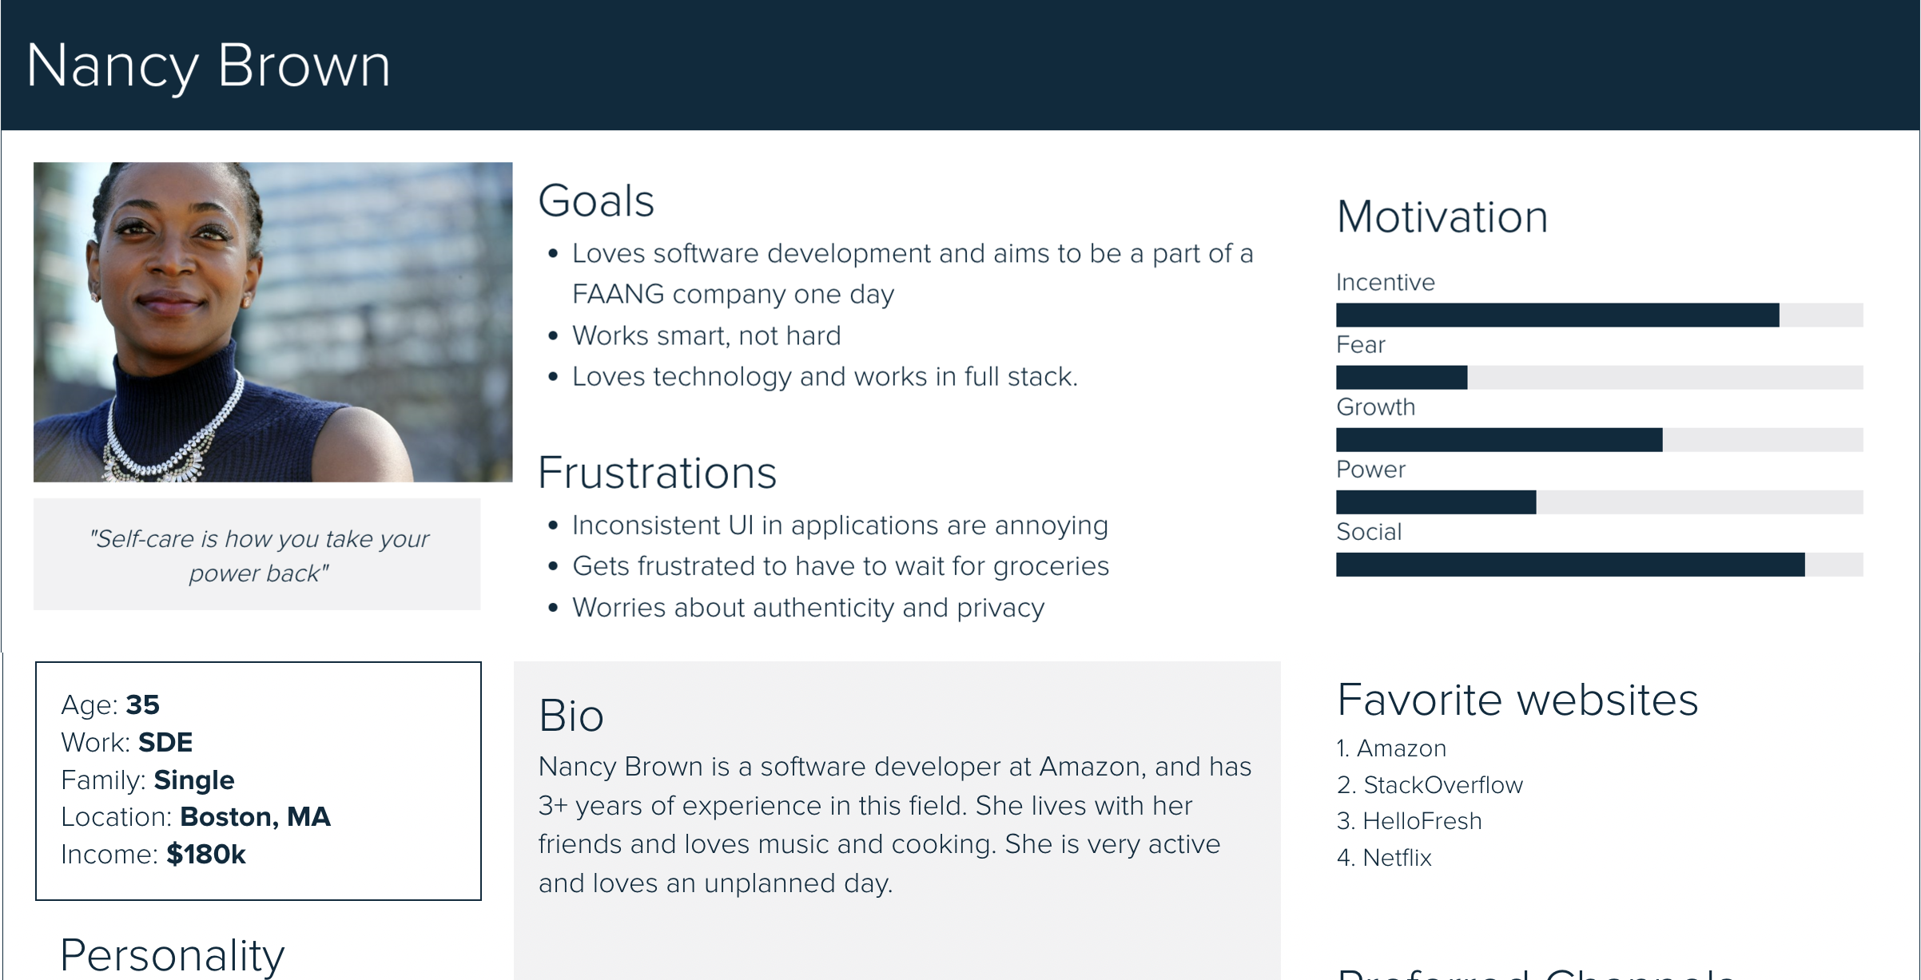

Slide 15
User needs
Clean and consistent UI and design
Instant delivery for users like working people
Scheduling the orders for future delivery
Mobile-friendly & optimized UI design
Easy sign-in and sign-up process in addition to guest sign in
Editing the placed order cart till the shopping is started for the scheduled order
Live update for store and inventory out-of-stock items
Live chat with the shopper and easy customer support

Slide 16
Research Methods

Slide 17
Competitive Analysis
Technique use to understand the competition, identify opportunities, and find an edge.
Provides UX design teams with valuable insights to develop a UX strategy that
enhances a product’s user experience and business value.
Helps to Develop a UX strategy and prioritize the design process
Discover how competitors solve similar usability issues
Determine competition strengths and weaknesses
Learn about trends and innovation
Building a new Product or Feature
Identify Market Gaps
Support Research

Slide 18
Competitive Analysis
This analysis was done at start of the process.
We analyzed competitors like Getir and Instacart and made an analysis of its drawbacks and possible areas of improvements.
For example, guest check out process, adding payment method through scanning of card, etc.
We decided to include the drawbacks as product features in our application and implemented them in our design.

Slide 19
Prototype Feedback & Testing
Creates a design mock-up or a feature prototype
Gathers feedback from your target audience on what to keep and what does not work for them
Identifies potential issues or validate product decisions.
Gathers insights for the current product and learn how it can be modified to best meet the users’ needs, whether that’s a product walkthrough or added in-product widgets.
We incorporated this method by making high fidelity wireframes and prototypes using Moqups and Figma.

Slide 20
Card Sorting
Card sorting is a UX research method in which study participants group individual labels written on notecards according to criteria that make sense to them.
Card sorting should be done when you’ve got the information you need to organize, but you’re just not sure exactly how to organize it.
The different techniques of card sorting are:
Open card sorting
Closed card sorting

Slide 21
Open Card Sorting
Users are free to assign whatever names they want to the groups they’ve created with the cards in the stack.
User is given a stack of cards that are pre-filled out with topics, then they group these cards.
After that, the participant creates labels for the groups that they chose.
Useful to design a new website or improve an existing one
The analysis helps to see whether the website structure matches up with how people would organize the same information.

Slide 22
Closed Card Sorting
Users are given a predetermined set of category names and are asked to organize the individual cards into these categories.
Does not reveal how users conceptualize a set of topics. Instead, it is used to evaluate how well an existing category structure supports the content, from a user’s perspective.
Helps to understand how well an existing category structure supports the content.
Closed card sorting works best for prioritizing and ranking features.

Slide 23
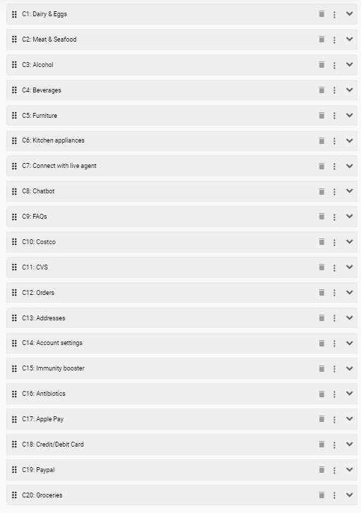
Cards used for Closed Card Sorting:

Slide 24
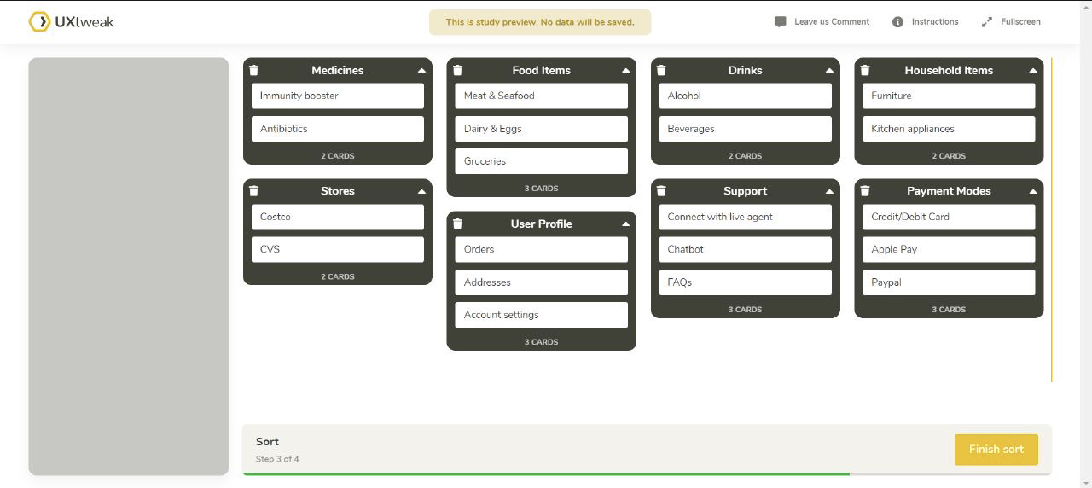
Closed Card Sorting by User

Slide 25
Information Architecture
Information Architecture focuses on the application's defined navigation structure.
The importance of Information Architecture in the UX design process grows in direct proportion to the amount of content a product contains
It’s basically a blueprint or a visual representation of the product’s infrastructure, features, and hierarchy

Slide 26
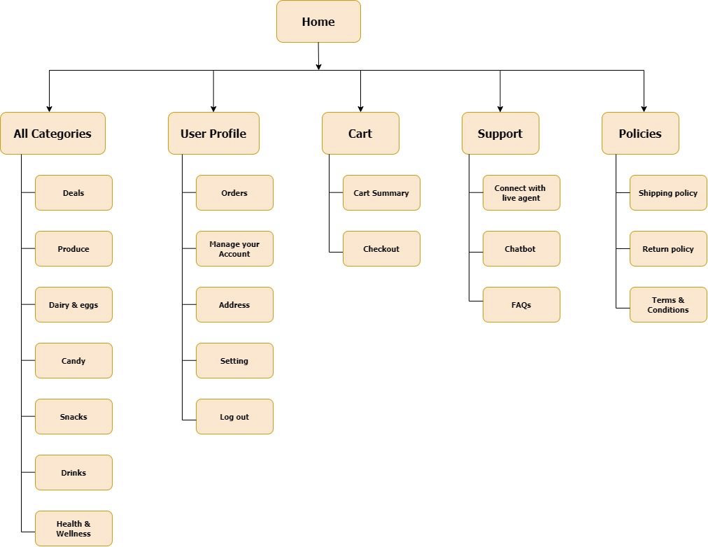
Information Architecture

Slide 27
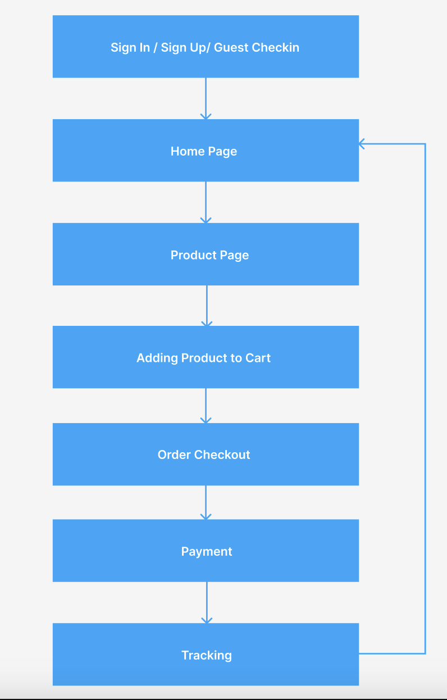
User Flow

Slide 28
Error Handling
Error handling is done to eliminate the error prone conditions
It exposes the interface
In GetEasy, we make use of inline input validation and describe the error message and let the user know what form of data to enter.

Slide 29
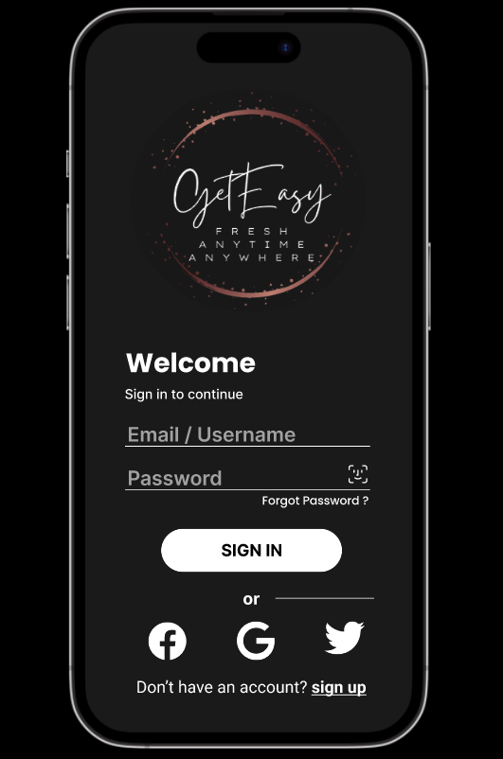
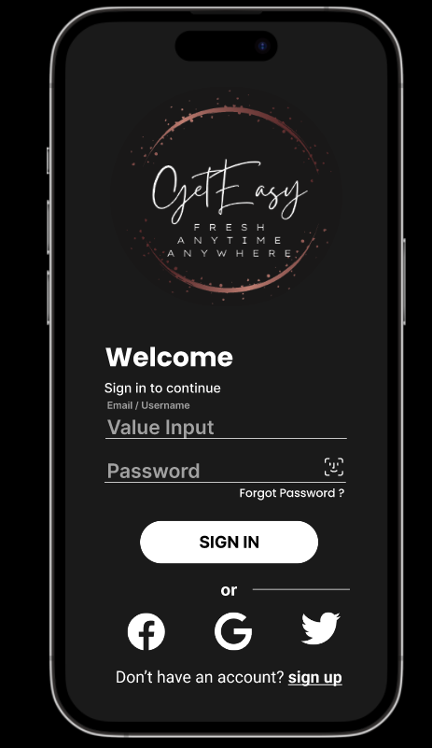
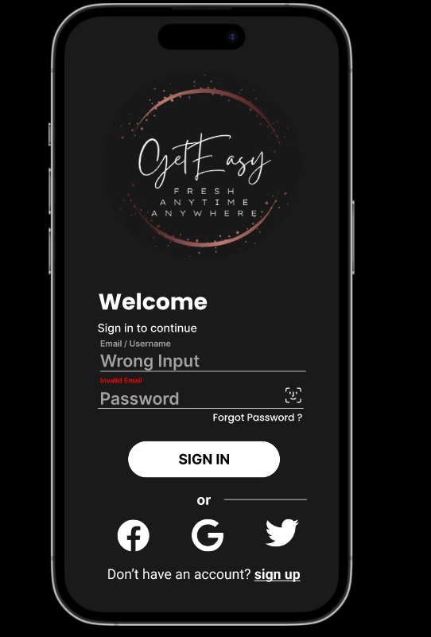
Error Handling (Screenshots)

Slide 30
Usability Testing Objectives & Tasks
The process of discovering ways to improve the product by observing users as they engage with the product or its prototype.
UX research method specifically trained on the usability of your products.
In a usability-testing session, a researcher asks a participant to perform tasks, usually using one or more specific user interfaces.
While the participant completes each task, the researcher observes the participant's behavior and listens for feedback

Slide 31
Users | Sign Up | Payment | Tutorial
User 1 | Clear step. Useful error messages. | Usual method that includes all forms of payment | Very long. Could be brief.
User 2 | Common step, familiar with how to do it without external help. | Ease in payment due to scanning of card | Very informative.

Slide 32
Use of Each Plane
There are five planes – Strategy, Scope, Structure, Skeleton and Surface Plane.
Strategy Plane: It addresses the user needs & the product objectives, the issues and the expected outcome. Different research methods like surveys and competitive analysis were conducted. And it was analyzed that this application was meant for users who preferred fast delivery and easy ordering of items with flexibility in terms of time, while at the comfort of their own home.
Scope Plane: In the scope plane, we learnt how to take user and product goals and convert them into product features. Moscow helped us prioritize the functions and features of the application. For example – order payment forms, guest check in, fast delivery, flexible schedules for placing an order.
Structure Plane: It defines how users navigate to specific information and where they go next. Information architecture is included in the plane.
Skeleton Plane: Defined the user flow of the application, and the components used to incorporate user interaction. The application was designed using Moqups wireframe.

Slide 33
Use of Each Plane
Surface Plane: Ensured the visual representation and the aesthetics of the application was on point. Added images, interactions, graphical components. Figma was used to achieve the high-fidelity prototype of the product.

Slide 34
Onboarding
Onboarding is the process of guiding users to navigate through and find value in the product. The different ways to implement user onboarding in our ecommerce website is by:
Tutorials – the user will be given a tutorial on how to navigate through the website using arrow marks, which the user is free to go ahead with or skip if not interested.

Slide 35
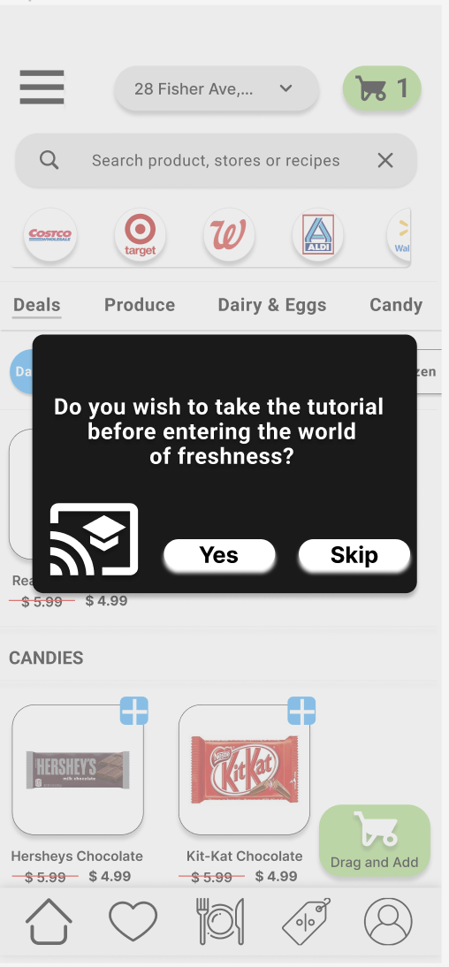
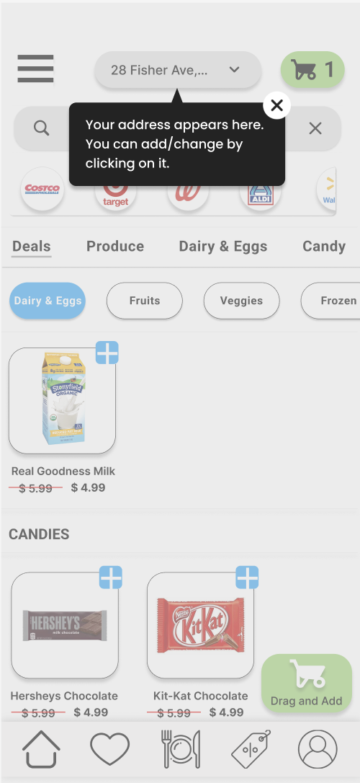
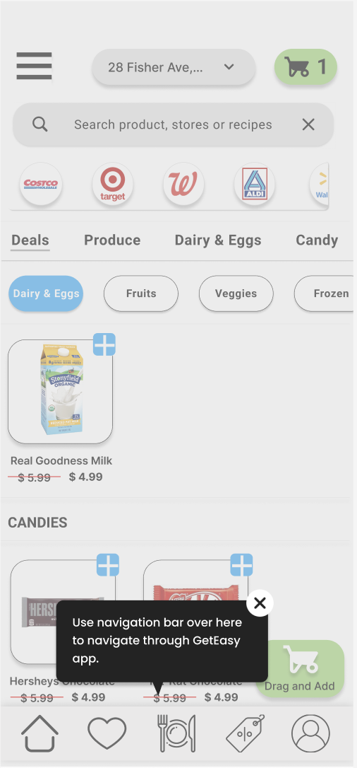

Slide 36
Demo…

